Slide 1
Overwatch: Enhanced Survaillance
Bryan Garcia

Slide 2

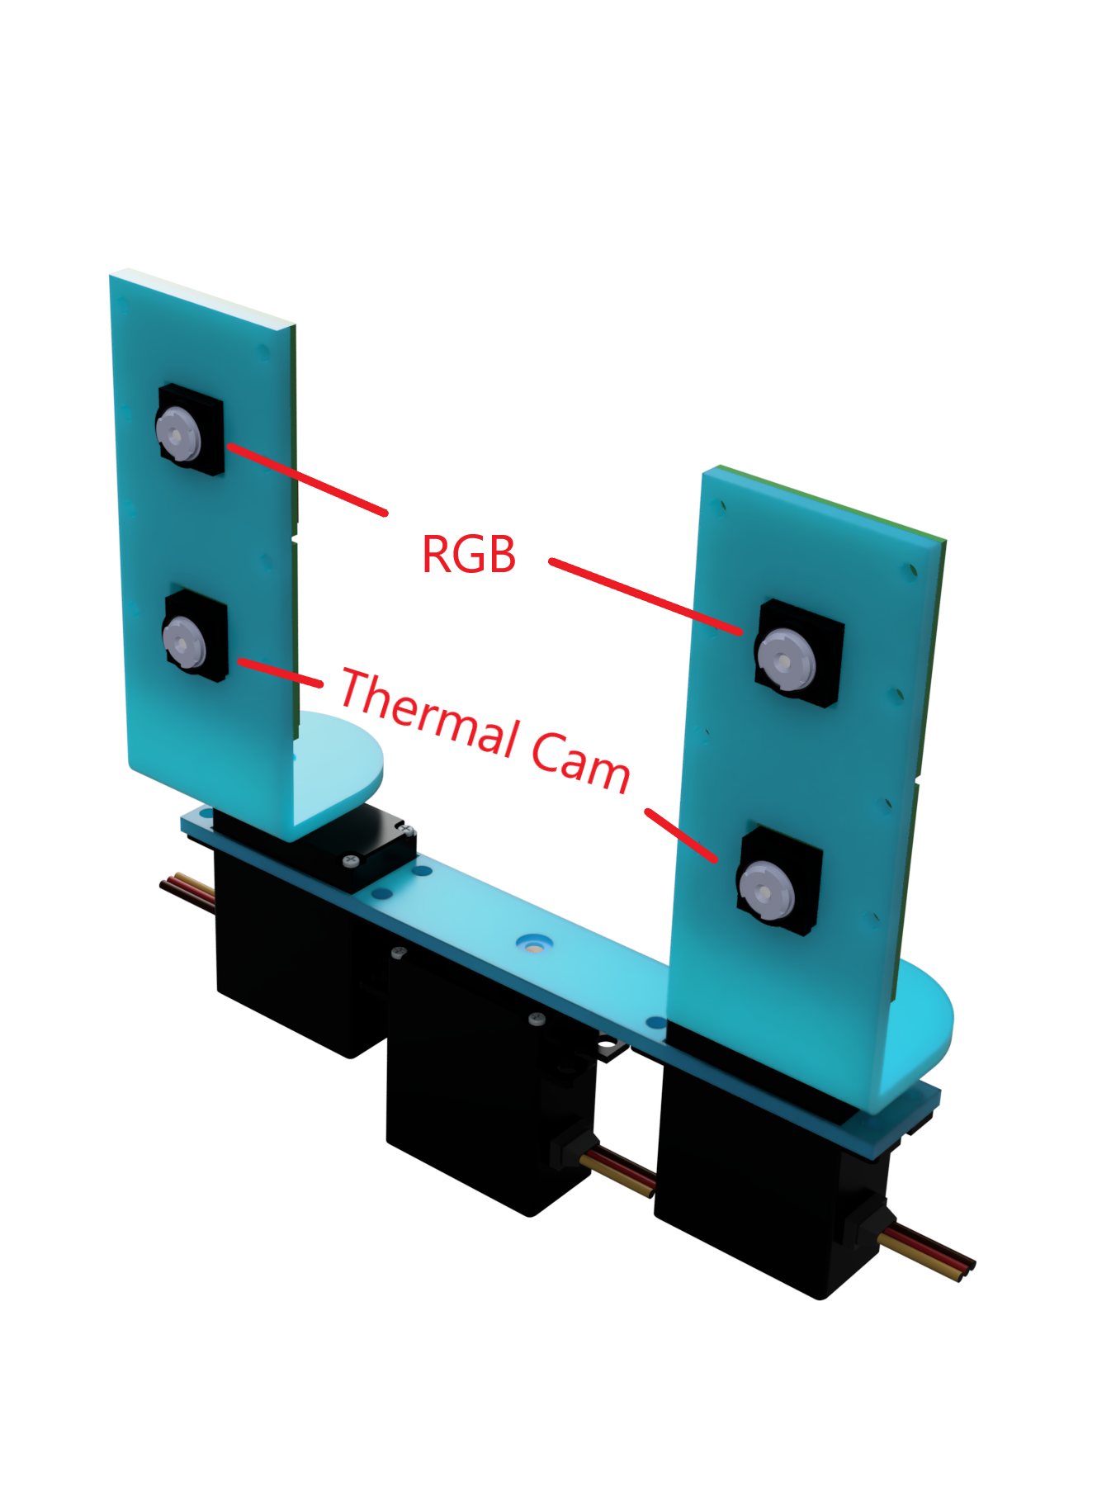
How is it different?
Most surveillance Equipment in the market rely entirely on RGB cameras
They use sophisticated computer vision algorithms but limit themselves with flat RGB image
Overwatch will be able to detect eminent threat faster under any unknown surrounding

Slide 3
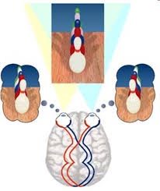
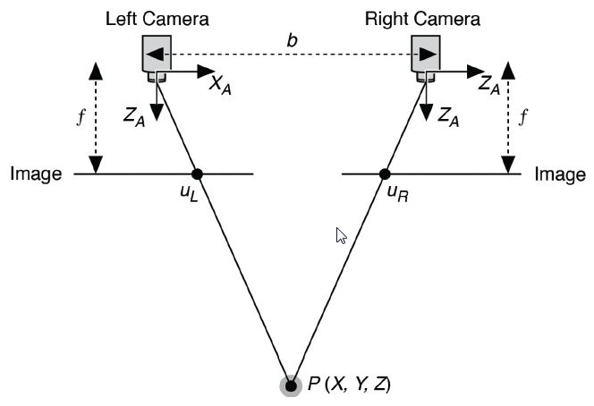
Stereo Vision
Stereo vision is found predominantly in nature
It allows the user the use of depth to navigate their environment.

Slide 4
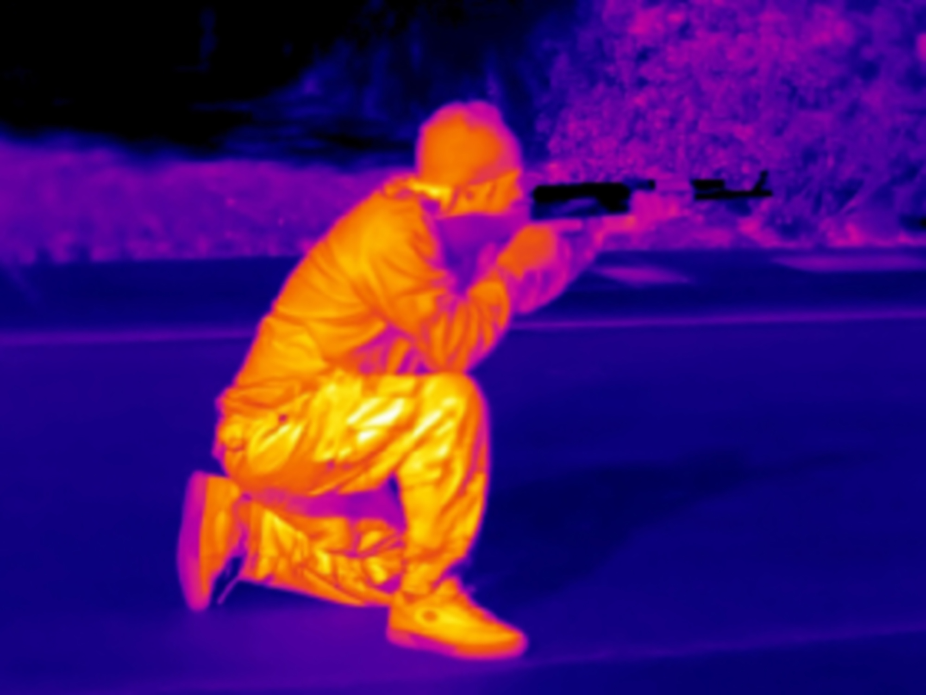
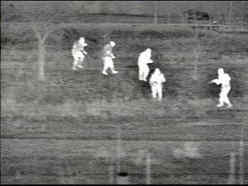
Thermal Camera

Slide 5
Process
The two RGB cameras will be constantly searching for human bodies on screen.
Once one camera has classified something on the screen to be human the thermal camera will be used to confirm it is a living organism based on the levels of IR being emitted by the source.
After confirmation, the two other cameras will turn around in search for the same object to begin the tracking phase.
Using the stereo cameras we will be able to derive a distance to the object.
A level of threat will be assigned based on the distance and the object classified.

Slide 6
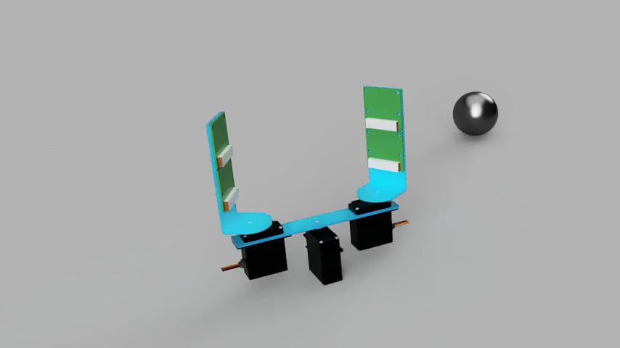
Expected End Results

